Slide 1
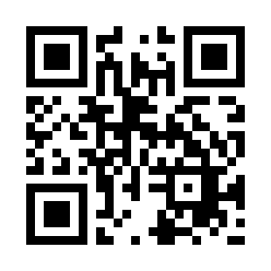

General SDLC Model Quiz
https://bit.ly/3Dr1628

